Slide 2





Slide 3
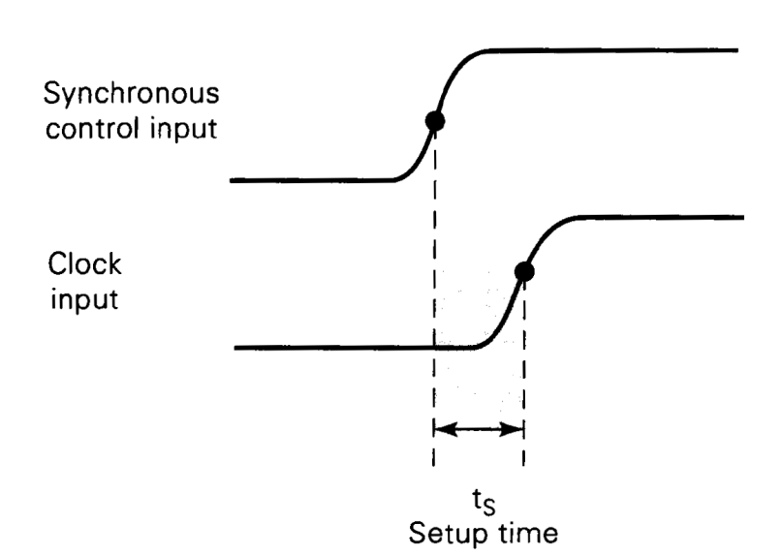
The set-up time is the minimum time period for which the synchronous inputs (for example, R, S, J, K and D and asynchronous inputs (for example, PRESET and CLEAR) must be stable prior to the active clock transition for the flip-flop output to respond reliably at the clock transition.
It is usually denoted by ts (min)

Slide 4
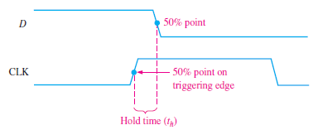
Hold Time
The hold time tH (min) is the minimum time period for which the synchronous inputs (R, S, J, K, D must remain stable in the desired logic state after the active clock transition for the flip-flop to respond reliably.

Slide 5
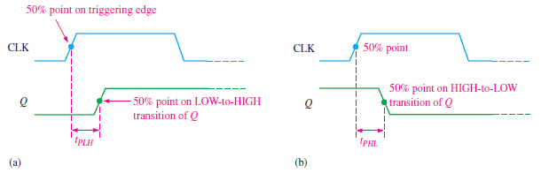
Propagation Delay
A propagation delay time is the interval of time required after an input signal has been applied for the resulting output change to occur.
Propagation delay t_{PLH} as measured from the triggering edge of the clock pulse to the LOW-to-HIGH transition of the output.
Propagation delay t_{PHL} as measured from the triggering edge of the clock pulse to the HIGH-to-LOW transition of the output.

Slide 6
Maximum Clock Frequency
The maximum clock frequency (f_{max)} is the highest rate at which a flip-flop can be reliably triggered. At clock frequencies above the maximum, the flip-flop would be unable to respond quickly enough, and its operation would be impaired.

Slide 7
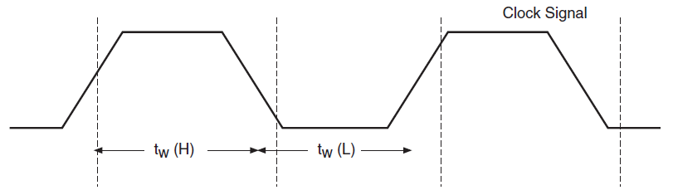
Pulse Widths
Minimum pulse widths (tW) for reliable operation are usually specified by the manufacturer for the clock, preset, and clear inputs. Typically, the clock is specified by its minimum HIGH time and its minimum LOW time.
The clock pulse HIGH time t_{W}(H) and clock pulse LOW time, t_{W} (L) are respectively the minimum time durations for which the clock signal should remain HIGH and LOW.

Slide 8
Power Dissipation
The power dissipation of any digital circuit is the total power consumption of the device.
For example, if the flip-flop operates on a +5 V dc source and draws 5 mA of current, the power dissipation is

Slide 9
Clock Transition Time
The manufacturers specify the maximum transition times (rise time and fall time) for the output to respond properly.
If the clock takes too long to make the transitions from one level to other , the flip-flop may respond erratically or even may not respond at all.

